Slide 1
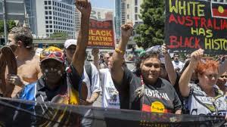
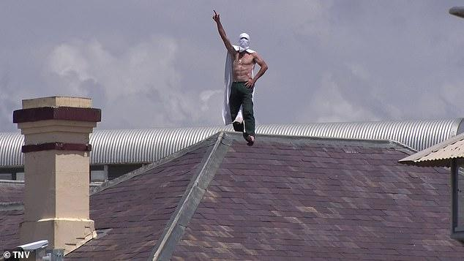
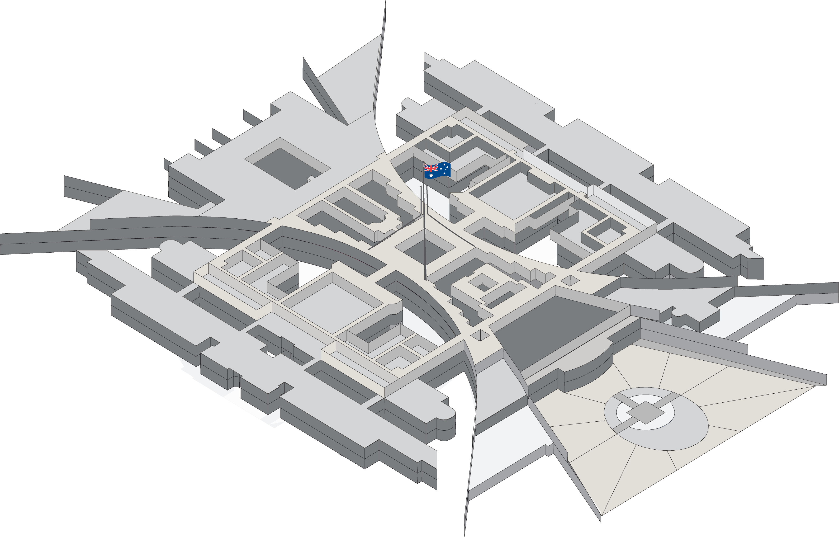
Prisoner and community resistance
to the effects of incarceration in Australia
“Threads of Resistance”
Deakin HDR-led Seminar
Cameron Russell
Deakin University

Slide 2
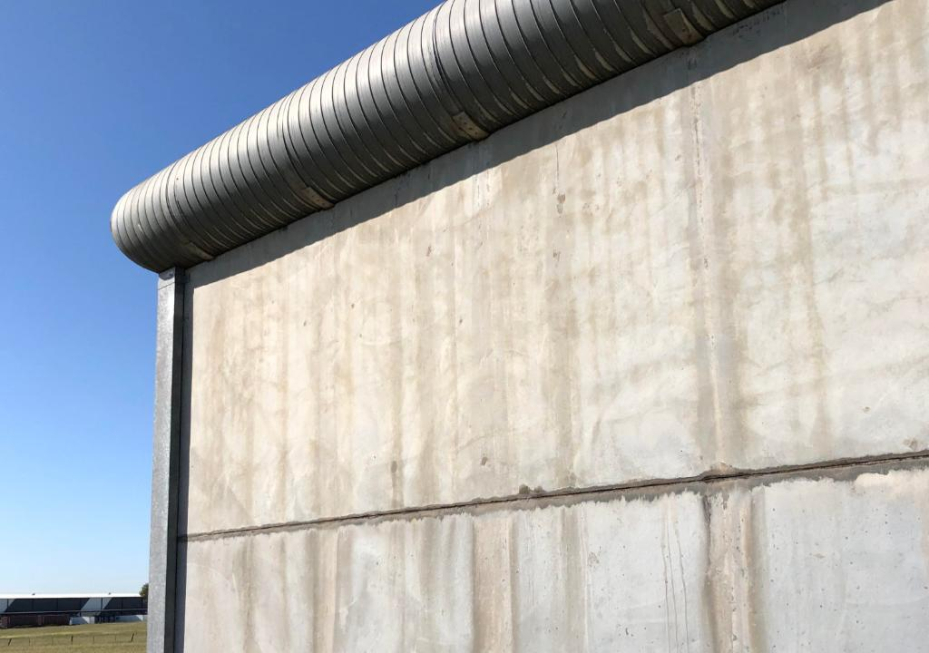

Acknowledgement of Country
I acknowledge and pay my respects to past, present and emerging Elders and Custodians of the land I’m joining you from, that of the Wathaurong people. Their stolen lands have never been ceded.

Slide 3
Overview
Prisoner & community resistance
to the effects of incarceration in Australia
Part 1: “Dignity” and “Dignity denied.”
Part 2: How individual prisoners & groups of prisoners resist
Part 3: How vulnerable communities resist
PowerPoint: aprj.com.au
(refer Vol.6, Iss.1, Art.2)

Slide 4
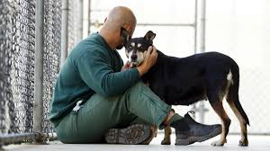
PART ONE: Dignity
Australian laws & treaties respect the inherent dignity of each Australian (AHRC n.d.)
All humans, including prisoners, have inherent dignity, whether a Human Rights Act/Charter exists in a nation or not (UNGA 1948)
Dignity
|
Human Rights
|
Humane treatment

Slide 5
Dignity denied
When a prisoner is not treated with dignity, they’ll resist with anger/ complaints/ frustration/ shame/ bitterness/ sorrow/ depression (in thoughts, words & deeds)
The outward resistance can be dangerous for prison staff & prisoners, & the inward resistance can affect the positivity & rehabilitation of prisoners

Slide 6
Definition
Resistance (in this presentation) =
+
Where the resistance:
needn’t be visible & recognised as resistance by others
needn’t be recognised as resistance by targets of the action
If intended, qualifies as resistance regardless of the outcome
(choices based on Hollander & Einwohner 2004:537-544)
action/ behaviour (verbal, cognitive or physical) by the authorities
opposition by prisoners, ex-prisoners, or the communities/ families of prisoners

Slide 7
Examples of dignity denied
Violence/excessive restraint/ridicule by officers. Soln: Improved recruitment & training, but note that restorative justice pioneers, Grimsrud & Zehr, consider incarceration to be morally & socially unacceptable state-sponsored violence. Soln: Crime prevention, diversion from prison & decarceration. Also justice reinvestment (discussed in Part 3) & restorative justice (moving from retribution to restoratively addressing the victim, criminal, families & community with rehabilitation reconciliation & healing)

Slide 8
Examples of dignity denied (cont.)
Strip searches Soln: Using safe scanning machines, better policy-making & training
Poor/denied medical care or forced medication/sedatives. Soln: Banning forced meds & chemical restraint; extending Medicare, NDIS & the PBS to prisoners & providing support for this within prisons
Solitary confinement/long periods in cages. Soln: Restricted use & as a last resort

Slide 9
Examples of dignity denied (cont.)
Overcrowded cells/ small beds or mattresses on the floor/ lack of privacy. Soln: Crime prevention; non-custodial alternatives to incarceration; justice reinvestment; restorative practices; throughcare; decarceration (especially for non-violent offenders)
Untreated pest infestations & mould in cells. Soln: Legally require immediate treatment

Slide 10
Examples of dignity denied (cont.)
Denial of/restrictions to visits/ family letters/ showers/ exercise in yard (incl. lockdowns as retribution or due to understaffing). Soln: Avoid denial of basic human rights
Waiting long periods at multiple gates to get where they need to be (e.g. to industry/ education/ clinic). Soln: Better staffing & training, or put AI in charge with supervision

Slide 11
PART TWO: Prisoner resistance

Slide 12
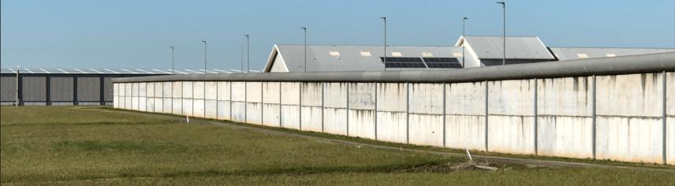
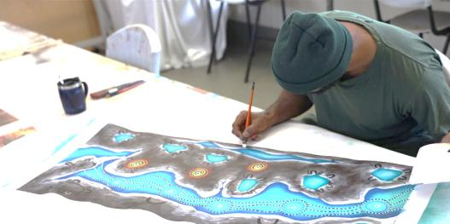
The choice (whether conscious or unconscious)
Put up with it > be dehumanised & institutionalised
OR
Resist > maintain dignity, mental health & autonomy

Slide 13
Examples of outward resistance
Questioning/ complaining to/ swearing at/ threatening officers
Complaining to ombudsmen, inspectors & politicians (although complaint forms tend to get lost or misdirected)
Non compliance with prison rules & dress code, sourcing better food, illicit privacy
Particular hairstyles or jail tattoos
Urinating & defecating in cells & washing the sewerage out of the cells

Slide 14
Examples of outward resistance (cont.)
Escapes, protests & strikes, burning/ defacing/ damaging/ stealing property, hunger strikes & riots
Secretly distilling alcohol or smuggling in & taking drugs (and forming gangs or other associations to further such illicit activities)
Violence against officers (which may include threats/revenge upon release)
Violence against other prisoners (to release anger & frustration, or as revenge against someone who did not join the collective prisoner action)

Slide 15
Examples of inward resistance
Refusing to become bitter, frustrated, angry, bored or depressed (e.g. through comradery or humour)
Reacting to the oppressive system by self-educating, keeping positive, reading, artwork, writing letters, physical exercise, working hard in industry (or refusing to work in industry), & finding ways to make decisions (rather than becoming institutionalised)
Aboriginal people maintaining (or learning) cultural practices while in prison & returning to the land that is significant to them upon release

Slide 16
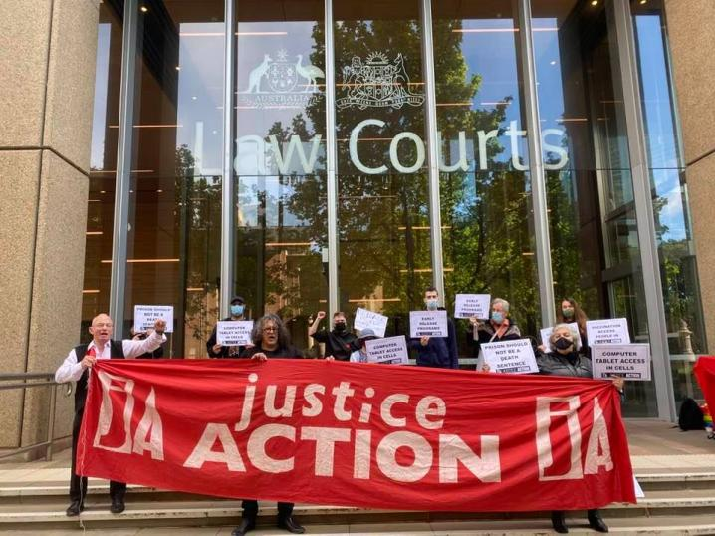
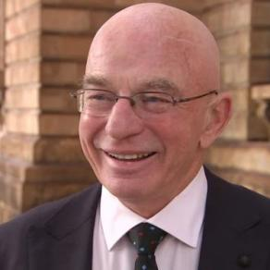
Prisoner outward resistance case study
Brett Collins,
Coordinator,
Justice Action

Slide 17
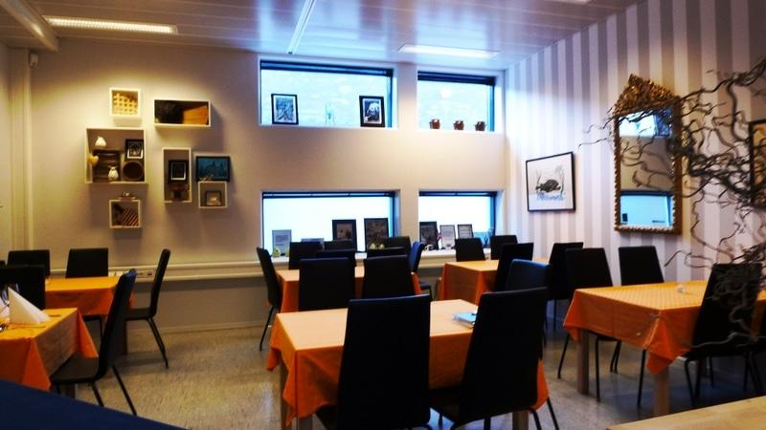
Prisoner inward resistance case study
Training restaurant, Halden Prison, Norway

Slide 18
PART THREE: Community resistance

Slide 19
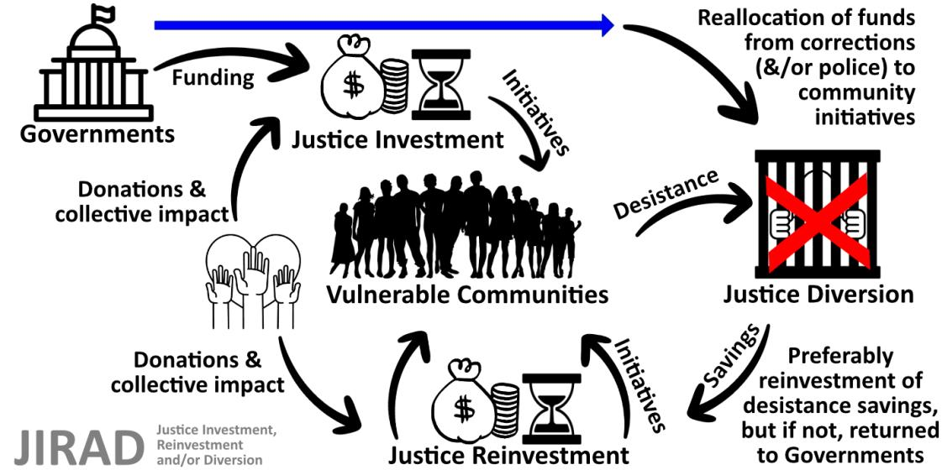
Justice reinvestment

Slide 20
Thesis title
“Strengths-based strategies for justice investment, reinvestment & diversion (JIRAD) in Australia”
Notes:
  Western criminology & related applied social sciences such as psychology tend to focus on a need/issue & attempt to meet/solve it
  Needs-based focus can ignore strengths-based JR
  Most Australian JR initiatives have been launched by & in remote Aboriginal communities

Slide 21
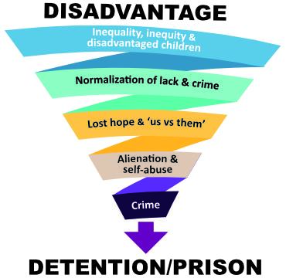
The downward spiral to prison
In these disadvantaged postcodes:
Low high school completion rates
Low employment rates
Low opportunity & income levels
Poor sport & recreational facilities
Poor physical and mental health
High substance abuse rates
High homelessness rates
High levels of boredom & trauma
Leading to:
High crime rates
High incarceration rates
High recidivism rates
(Glass 2015; Vinson 2007)

Slide 22
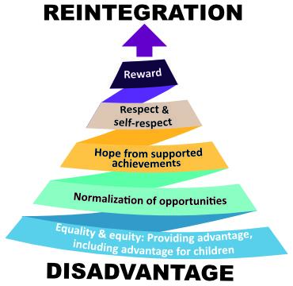
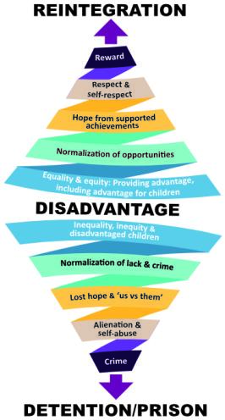

The upward spiral to reintegration

Slide 23
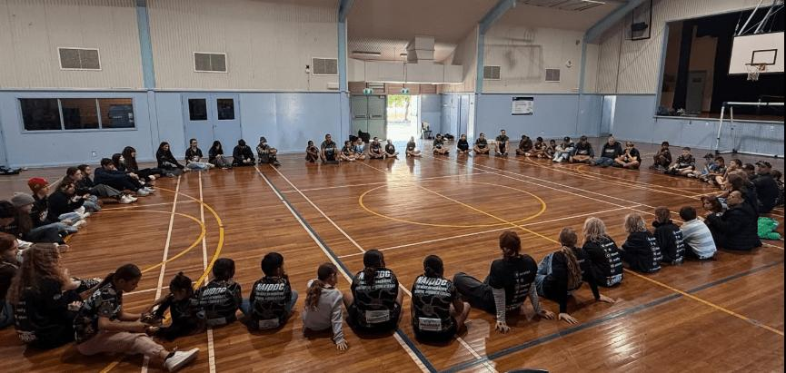
Community resistance case study
Sitting in a yarning circle after a sports event, Maranguka JR initiative, Bourke

Slide 24
Community resistance case study (cont.)
Improvements from justice reinvestment in 2017
A 38% reduction in charges across the top five juvenile offence categories; 27% reduction in juvenile bail breaches; 31% increase in year 12 retention rates; and 84% rise in the completion rate for VET courses by Bourke secondary school students
83% increase in licences through a Learner Driver Program
23% reduction in police-recorded domestic violence incidents
AUD 3.1 million gross impact, with only AUD 0.6 million operational costs. Two thirds of this impact benefitted the justice system and the other third benefitted the region economically.
(KPMG 2018)

Slide 25
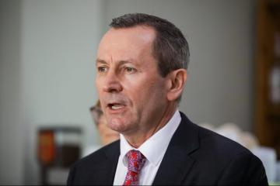
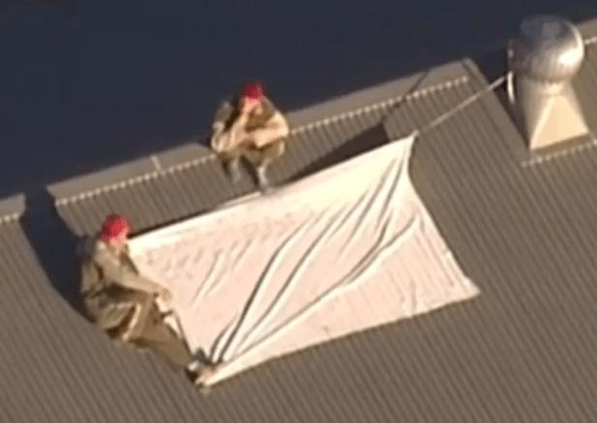
Conclusion
Example of detailed sensationalist reporting of the protest, police regaining of control and Premier McGowan’s outrage; in combination with the under-reporting of the serious reasons for the protest: Burmas 2023
Prisoners on roof of Woodford Correctional Centre call for the “Suboxone program”

Slide 26
Selected references
AHRC [Australian Human Rights Commission] (n.d.) ‘Human rights & prisoners’, Information Sheet.
ALRC [Australian Law Reform Commission] 2018 ‘”What is Justice Reinvestment?” Pathways to justice: Inquiry into the incarceration rate of Aboriginal and Torres Strait Islander Peoples’, ALRC Report 133.
Burmas G (10 May 2023) ‘Banksia Hill Detention Centre riot over as armed officers move in to arrest teenagers on roof’, ABC News.
Calma T (2009) ‘Social Justice Report 2009’, Aboriginal and Torres Strait Islander Social Justice Commissioner, Australian Human Rights Commission, Sydney.
Glass D (2015) ‘Investigation into the rehabilitation and reintegration of prisoners in Victoria‘, Victorian Ombudsman (16 September 2015).
Grimsrud T and Zehr H (2002) ‘Rethinking God, Justice, and Treatment of Offenders’, Journal of Offender Rehabilitation, 35(3):253-279.

Slide 27
Selected references (cont.)
Hollander JA and Einwohner RL (2004) ‘Conceptualizing resistance’, Sociological Forum, 19(4):533-554.
Just Reinvest NSW (n.d.) ‘Bourke (Maranguka): Ngemba Country (‘caring for others’, Just Reinvest NSW, accessed 31 August 2025.
KPMG (2016) ‘Unlocking the Future: Maranguka Justice Reinvestment Project in Bourke Preliminary Assessment’, KPMG.
KPMG (2018) ‘Maranguka Justice Reinvestment Project: Impact Assessment’, (Audit Report), KPMG.
Maranguka Limited (n.d.) ‘2023-2025 Maranguka Limited: Strategic Plan’, Maranguka Community Hub, Bourke, NSW, Australia.
PCYC (2025) ‘PCYC Bourke’, Police Citizens Youth Clubs, Bourke, Australia, accessed 28 August 2025.

Slide 28
Selected references (cont.)
Sacred Sports (2025) ‘Sacred Sports: Background’, Sacred Sports, Bourke, Australia.
Tucker SB and Cadora E (2003) ‘Ideas for an Open Society: Justice Reinvestment: To Invest in Public Safety by Reallocating Justice Dollars to Refinance Education, Housing, Healthcare, and Jobs’, Open Society Institute 3(3):1-5.
UNGA [United Nations General Assembly] (1948). ‘Universal Declaration of Human Rights’.
Vinson T (2007) Dropping off the edge: The distribution of disadvantage in Australia, Jesuit Social Services, Richmond, Victoria, Australia.
Vinson T and Rawsthorne M (2015) ‘Dropping off the Edge: Persistent communal disadvantage in Australia’, Jesuit Social Services, Richmond, Victoria, Australia.

Slide 29
Image credits
Australian Parliament House: PEO (Parliamentary Education Office - peo.gov.au), 2025.
Banksy mural: ‘Create Escape’, mural painted on the wall of the former Reading Prison (as a likely reference to Oscar Wilde & others who were imprisoned there), CNN, 5 March 2021.
Brett Collins: Photograph used by permission.
Children in a circle: Sacred Sports, 2025.
Indigenous deaths in custody protest: Sydney Morning Herald, 7 April 2021.
Justice Action outside NSW Supreme Court: Justice Action, 6 October 2021.
Prisoner creating artwork: WA Department of Justice, 12 May 2023.
Prisoner on prison roof: TNV/Daily Mail, 20 January 2020.
Prisoner with dog: Daily Telegraph, 19 September 2020.

Slide 30
Image credits (cont.)
Spiral infographics: SlideModel.com, royalty free for subscribers.
Training restaurant, Halden Prison: Exhibition, Oslo School of Architecture and Design, 28 August – 13 September, 2018.
WA Premier McGowan: Burmas G 10 May 2023 (photo: Bourke K, ABC News).
Woodford prisoners: Brisbane Times, 6 July 2016 (photo: Nine News Brisbane).
All other photographs: Taken by the author, 2022-2025.

Slide 31

References & image credits
Available to view at your leisure at:
aprj.com.au (Vol.6, Iss.1, Art.2)
Cameron Russell
Thank you

Slide 32
Discussion questions
What are your views on violent and destructive prisoner resistance?
Many activists outside prison complain that prison industry is treating prisoners as virtual slaves because they are paid about $45/week. The states can make profits from the industries (over $50 million per year in NSW, for example), which may be reinvested in the prison system. Almost all prisoners, however, try to get into industry because it relieves the boredom, & when they get a job, they take pride in working hard & can use that as a possible pathway to employment upon release (despite their criminal record & stigma). A prisoner who refuses to work in industry is clearly engaging in resistance. Do you think that the prisoners who are working in industry are also engaging in resistance?

