Slide 1
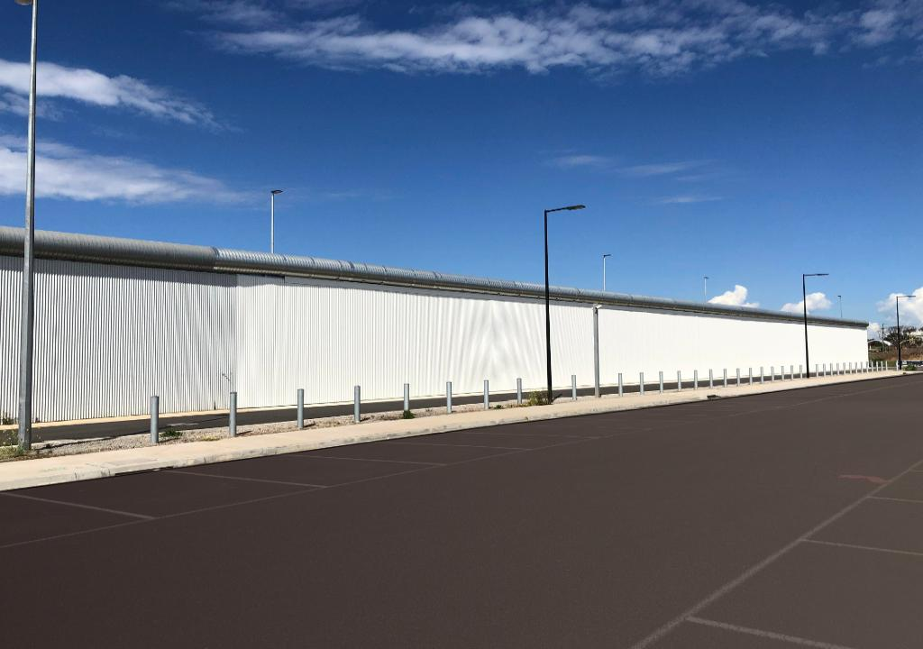
Prisons as environmental crime
Cameron Russell
Deakin University
www.aprj.com.au

Slide 2
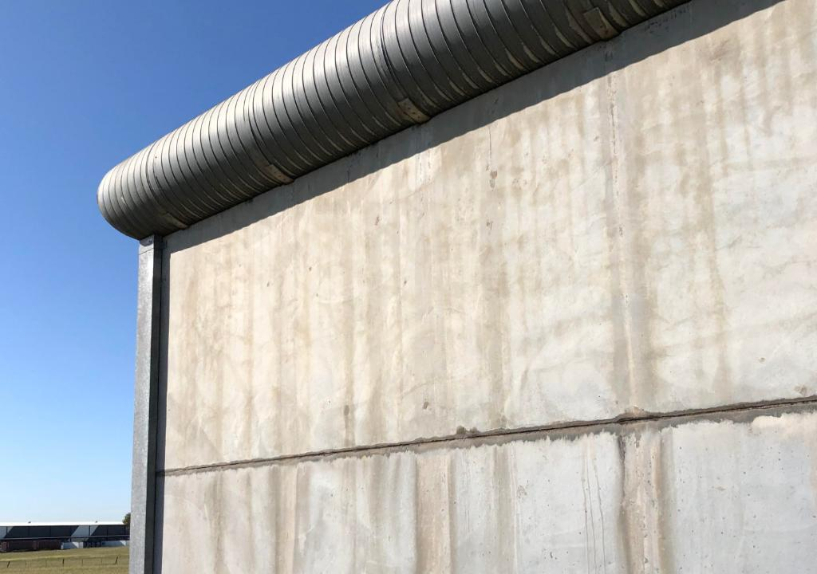

Acknowledgement of Country
I acknowledge and pay my respects to past, present and emerging Elders and Custodians of the land on which we meet, the Wadawurrung people. Their stolen lands have never been ceded.

Slide 3
Overview
Are prisons green crimes?
PowerPoint: aprj.com.au
(refer Vol.5, Iss.1, Art.3)

Slide 4

‘Green crimes’ definition (1)
Law-based definition: Illegal activities and/or omissions that harm, destroy, degrade, threaten or place at risk the environment, ecology and/or species
(amalgam of definitions by AFP, Europol, Situ & Emmons, Higgins, Walters)

Slide 5
‘Green crimes’ definition (2)
Non-law-based (or harm-based) definition: Grave offenses against the environment, ecology and/or species including any activities and/or omissions that cause them harm, destruction, degradation, threat or risk
(akin to Earth lawyer, Polly Higgins’ definition of ‘ecocide’ which linked severely diminished ‘peaceful enjoyment’ with international crimes under the Rome Statute being against peace)

Slide 6
Jewkes and Moran:
‘…the expansion of correctional systems… has been widely criticized by criminologists and others for its financial and human costs but the environmental cost of mass incarceration has yet to attract widespread critique.’

Slide 7
3 green injustices of imprisonment
It is submitted that green criminologists should generally oppose mass incarceration due to the following 3 green injustices:

Slide 8
1. Environmental injustice
Environmental discrimination stems from the environmental racism movement (1970s-80s): disadvantaged people observed to live in inferior environments with less nature and more waste
Prisoners are from disadvantaged backgrounds & live in inferior environments

Slide 9
Environmental injustice - Reported examples
Temperature extremes (e.g. Roebourne C.C. & Alice Springs C.C.)
Mouse and cockroach infestations (e.g. Hakea Prison & Wellington C.C.);
Overcrowding (e.g. Darwin C.C. & John Moroney C.C.)
Not evacuated when floods and fires nearby (e.g. Lithgow C.C. and Geoffrey Pearce C.C.)
Built on swamps (e.g. John Moroney C.C.) or contaminated former landfill/industrial sites (e.g. the site in Camellia, Western Sydney proposed for a prison for 1000 inmates)
(Tanton et al. 2021:11; Farcic 2013; Gregory and Lowther 2021; Edwards 2022; Bradshaw 2018)

Slide 10
Environmental injustice - Specific example: Silverwater
1163-inmate prison built on landfill (Bradshaw Rubbish Tip)
Soil known to contain ‘moderate to high levels of contamination’
2.5m to 13m of waste fill below thin 1m clay surface layer as a cap (which is leaking gas so a health & fire risk for prisoners & Sydneysiders)

Slide 11
Environmental injustice - Silverwater (cont.)
Prison extended for 440 prisoners. Environmental assessment: “Significant contamination”
Toxins identified: Benzene, toluene, BTEX, PAHs, OCPs, PCBs, many heavy metals, asbestos, PFAS & much more
Water from this toxic site also draining 700m into Parramatta River

Slide 12
2. Ecological injustice
Prisons (and prison museums) are vast areas of concrete and bitumen with the occasional lawn, but largely devoid of creeks, lakes, trees and natural grasslands
In addition, tonnes of building materials and water are expended, along with energy, during the construction process

Slide 13
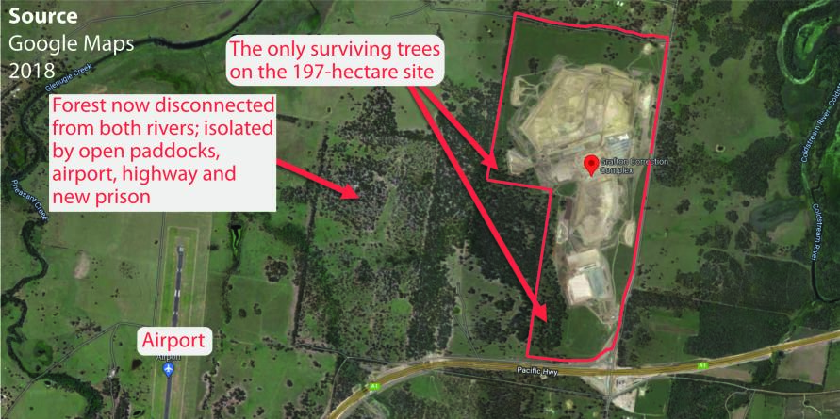
Ecological Injustice example: Clarence CC
Australia’s largest prison (197 ha, 1700 prisoners)
62 buildings + admin buildings + carpark for 700 + concrete and bitumen in between

Slide 14
Local Environment Plan:
Clarence C.C. (cont.)
Fails to meet multiple requirements of
the Development Control Plan, e.g.:
  ‘Development which is responsive to site constraints and the surrounding
  environment’
  ‘Development which is of high quality
  and is sensitive to the rural character of
  the locality in which it is being developed’
Built on Rural Landscape (RU2) land
Not 1 of the 8 RU2 objectives fulfilled

Slide 15
3. Species injustice
In constructing prisons, State and Territory governments have demonstrably failed to protect and improve native biodiversity and habitats of significant species as required by planning, development & environmental requirements
Governments do this by introducing enabling legislation, paying offsets, etc

Slide 16
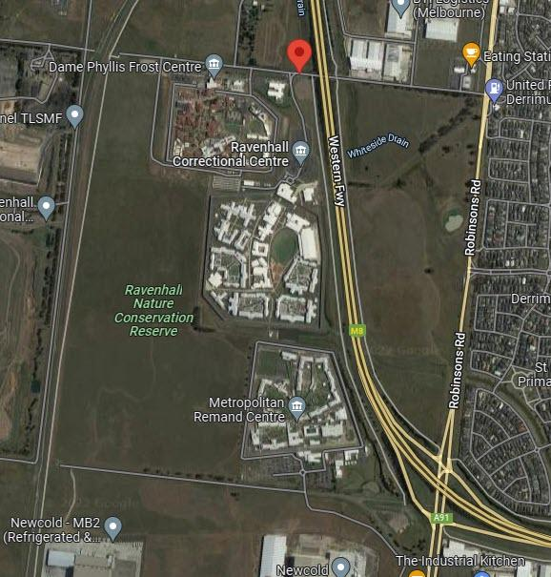
Species injustice example: Ravenhall C.C.
40.5 ha site
(+ 6.6 ha
surrounds)
‘High value’ grasslands destroyed
Significant flora and fauna species on the site - destroyed

Slide 17
Species injustice example:
Ravenhall C.C. (cont.)
Biosite of State significance included 16.35 ha of native vegetation, 0.02 ha of ‘high conservation’ significance and 7.26 ha of ‘very high conservation significance’
Minister for Planning determined an Environmental Effects Statement (EES) not required
DOJ paid offsets for the destruction

Slide 18
Offsets
Governments routinely pay offsets when constructing prisons. However, under State, Territory and Federal legislation, offsets are generally an exceptional option only after attempting to avoid or mitigate any impacts. Even then, offsets are not to make an unacceptable impact acceptable.
‘You just can’t ‘offset’ critical habitat of this nature’ (Greens Environment spokesperson, Rosalie Woodruff 2021)

Slide 19
Conclusion
Prisons (including the oxymoron ‘green prisons’) perpetuate ineffective retributive justice and green injustices; are a huge burden on the tax system; and are green crimes in the sense of causing grievous harm to the environment
John Braithwaite: Restorative justice techniques first, offering carrots but reserving the stick of imprisonment as a last resort (Braithwaite 2019).

Slide 20
Conclusion (cont.)
Scott sees no need for a new Northern Prison in Tasmania if the Government invests the same amount in crime causes, rehabilitation, prison-based reintegration, and community services for employment, housing, education, training and other support
Cunneen et al. advocate early release; abolition of short sentences; justice reinvestment; therapeutic jurisprudence such as the use of drug courts; specialist courts for mentally ill, homeless or Aboriginal people; & attention to colonialism, post colonialism & race as drivers of incarceration

Slide 21
Selected references
Available to view at your leisure at:
aprj.com.au (Vol.5, Iss.1, Art.3)

Slide 22
Thank you
Contact details: PowerPoint:
Cameron Russell aprj.com.au
e: info@aprj.com.au Vol.5, Iss.1, Art.3

Slide 23
Selected references
Aertsen I (26 April 2019) ‘Restorative justice responses to environmental harm and ecocide’, International Seminar, Katholieke Universiteit Leuven, Belgium.
AFP (Australian Federal Police) (n.d.) ‘Environmental crime’, accessed 09 April 2022.
Artefact (2018) ‘Metropolitan Remand and Reception Centre: Heritage Impact Assessment: Report to the Department of Justice on behalf of GHD’, accessed 29 April 2022.
BBC Consulting Planners (2017) ‘Environmental Impact Statement: New Grafton Correctional Centre’, Broadway, NSW.
Billiet C and Rousseau S (2014) ‘How real is the threat of imprisonment for environmental crime?’, European Journal of Law and Economics, 37(2):183–198, doi: 10.1007/s10657-011-9267-2
Bradshaw EA (2018) ‘Tombstone towns and toxic prisons: Prison ecology and the necessity of an anti-prison environmental movement’ Critical Criminology, 2018.
Braithwaite J (2002) ‘Restorative justice and responsive regulation’, in Tonry M and Morris N (eds) Studies in crime and public policy, Oxford University Press, Oxford.
Cunneen C, Baldry E, Brown D, Brown M, Schwartz M and Steel A (2016) Penal culture and hyperincarceration: The revival of the prison, Advances in Criminology series, Routledge, London.

Slide 24
Selected references (cont.)
CVC (Clarence Valley Council) (2011) ‘Rural Zones: Development Control Plan’, Clarence Valley Council, NSW.
—(2020) ‘Local Strategic Planning Statement’, accessed 13 April 2022.
—(2022) ‘Lot 1 of Plan No 1190399 & Lot 26 of Plan No 751376’, Cadastre for Clarence Correctional Centre, Avenue Road, Lavadia, NSW.
DW News (Deutsche Welle News) (2021a) ‘Ecocide explained: How activists want to hold those destroying the environment accountable’, accessed 24 March 2022.
EC (European Commission) (2016) ‘Is prison a real threat for environmental offenders?’, Science for environment policy, accessed 25 May 2022.
Edwards J (18 January 2022) ‘Incarceration in a changing climate’, Eureka Street, 32(1), accessed 24 April 2022.
Europol (n.d.) ‘Environmental crime’, accessed 03 April 2022.
Farcic E (17 January 2013) ‘Hakea prison ‘divided, vermin infested’’, The West Australian, accessed 24 April 2022.
GHD (2018) ‘Metropolitan Remand and Reception Centre Expansion: Review of environmental factors’, NSW Department of Justice.

Slide 25
Selected references (cont.)
Gregory X and Lowther N (22 June 2021) ‘Mouse plague 'invades' Wellington prison, forcing hundreds of prisoners and staff to evacuate’, ABC News, accessed 24 April 2022.
Higgins P, Short D and South N (2013) Protecting the planet: a proposal for a law on ecocide’, Crime, Law and Social Change, 59(3):251-266.
Jewkes Y and Moran D (2015) ‘The paradox of the green prison: Sustaining the environment or sustaining the penal complex’, Theoretical Criminology, 19(4):451-469.
Knaus C (29 December 2017) ‘Prisons at breaking point but Australia is addicted to incarceration’, The Guardian, accessed 28 May 2022.
Liu C, Aharony J, Richardson G and Yawson A (2016) ‘Corporate litigation and changes in CEO reputation: Guidance from U.S. Federal Court lawsuits’, Journal of Contemporary Accounting & Economics 12(1):15-34, https://doi.org/10.1016/j.jcae.2016.02.003
Lynch MJ, Stretesky PB and Long MA (2019) ‘Environmental crime prosecutions in Ireland 2004-2014’, International Journal of Comparative and Applied Criminal Justice, 43(4):277-293, doi: 10.1080/01924036.2019.1615520
Melton City Council (gazettal date: 31 January 2013) ‘Melton Planning Scheme: Amendment C136: Explanatory Report’, accessed 31 May 2022.
Moodie A (13 March 2016) ‘Getting off scot-free: how CEOs survive environmental controversies unscathed’, The Guardian (Australia), accessed 11 April 2022.
NSW Caselaw (2022) ‘Recent decisions for Multiple Courts, Criminal’, accessed 01-31 May 2022.

Slide 26
Selected references (cont.)
NSW Correctional Services (2020) ‘Silverwater Correctional Complex upgrade’, NSW Government, accessed 29 April 2022.
NSWLEC (Land and Environment Court of New South Wales) (2020a) ‘About us’, NSW Government, accessed 13 April 2022.
—(2020b) ‘Enforcement’, NSW Government, accessed 13 April 2022.
—(2020c) ‘Types of cases’, NSW Government, accessed 13 April 2022.
Scott C (22 June 2020) ‘New Northern Regional Prison – Bad policy in action’, Tasmanian Times, accessed 29 April 2022.
Situ Y and Emmons D (2000) ‘Environmental crime: The criminal justice system’s role in protecting the environment’, Sage Publications, https://dx.doi.org/10.4135/9781452232256
Symes C (1997) ‘Environmental law: Polluting activities’, Alternative Law Journal, 22(4):196-197.
Tanton R, Dare L, Miranti R, Vidyattama Y, Yule A and McCabe M (2021)‘Dropping off the Edge 2021: Persistent and multilayered disadvantage in Australia’, Jesuit Social Services, Melbourne.
Victorian Government (2014) ‘Ravenhall Prison: Correctional facility development plan’, accessed 25 May 2022.

Slide 27
Selected references (cont.)
Wahlquist C (19 March 2020) ‘Australia's overcrowded prisons could struggle to control coronavirus, expert says; Governments urged to show a similar level of care to protecting prisons as they do to protecting aged care homes’, The Guardian, accessed 28 May 2022.
Walters R (2019) ‘Ecocrime’, in McLaughlin E and Muncie J (eds) Sage Dictionary of Criminology, Sage Publications (4th ed), London.
Westcott V and McCutcheon C (2013) ‘Ravenhall Grasslands Nature Conservation Reserve: Flora survey: Final report’, Biosis (for Department of Justice).
Woodruff R (2021a) ‘Ashley Youth Detention Centre – Future use of site’, Tasmanian Greens MPs, accessed 13 April 2022.
Legislation
Clarence Valley Local Environment Plan 2011 (NSW)
Contaminated Land Management Act 1997 (NSW) [the CLM Act]
Environment Protection and Biodiversity Conservation Act 1999 (Cth) [the EPBC Act]
Environmental Planning and Assessment Act 1979 (NSW) [the EP&A Act]
Environmental Planning and Assessment Regulation 2000 (NSW) [the EP&A Regulation]
Land and Environment Court Act 1979 (NSW) [the LEC Act]

