Slide 1
Relationship between health & deaths in custody
Cameron Russell, Deakin University
Master of Criminology (Major Thesis)
Supervisor: Dr Clare Farmer
Victorian Postgraduate Criminology Conference
Held at the University of Melbourne on 4 Nov 2022
Panel 1

Slide 2

Acknowledgement of Country
I acknowledge and pay my respects to past, present and emerging Elders and Custodians of the land on which we meet, the Wurundjeri Woi Wurrung and Bunurong peoples of the Kulin Nation. These stolen lands have never been ceded.
Content advice
Aboriginal and Torres Strait Islander people are
respectfully advised that this thesis contains
references to people who have passed away.

Slide 3
The relationship between health & deaths in custody in Australia
Overview:
Problems:
  Extremely poor prisoner health
  Reduction in custodial deaths has reached plateau
One possible solution: If health and deaths in custody are related, improving prisoner health may reduce deaths

Slide 4

Background
Death rates in prison (2020-21):
Indigenous inmates died at a rate of 0.09 per 100 prisoners
Non-Indigenous inmates died at a rate of 0.18 per 100 prisoners
(AIC 2021b:Deaths in prison custody:Table B:1).

Slide 5
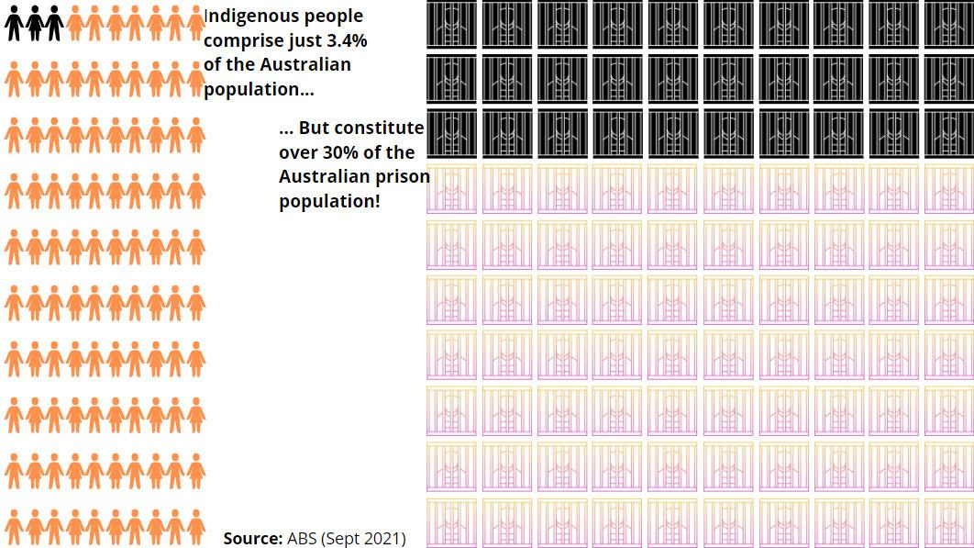
Indigenous people
comprise just 3.2%
of the Australian
population…
Indigenous
incarceration
… but constitute over 31% of the
Australian prison
Population!
(ABS 2022)
Plus the Indigenous death rate in police custody is 7.5 times higher

Slide 6
Deaths in prison custody since 1990
(rate per 100 relevant prisoners)
SOURCES: AIC 2021c:Deaths in prison custody:Tables D5,D6,D10.

Slide 7
Hypothesis
Narrow hypothesis (examined in this thesis): Poor prisoner health and healthcare in Australia are contributors to deaths in custody and health improvements are likely to reduce deaths in custody
Broad hypothesis (not examined in thesis): Prisoner health improvements are related to and likely to reduce recidivism, injury and death rates for those held in custody

Slide 8
Standard of healthcare required for
Australian (and Victorian) prisoners
Minimum: Prisoners should receive a comparable standard of healthcare to that received by the general community
Standards for health services in Australian prisons
Rules 24,25,27 of the UN Nelson Mandela Rules
Principles 4.1.4,4.1.5,4.1.8 of the Guiding Principles for Corrections in Australia [ETC]
States and Territories are given leeway to develop their own laws and standards (CSAC 2018)… In Victoria:
Correctional Management Standards for Men’s Prisons in Vic (2014)
Standards for the Management of Women Prisoners in Vic (2014)
Justice Health Quality Framework (2014)
Justice Health Performance Monitoring Program (for continuous improvement) (2014)
Commissioner’s Requirements (2021) [ETC]

Slide 9
Further prisoner health rights:
Right to access reasonable medical care and treatment necessary for the preservation of health - Section 47(1)(f) of the Corrections Act 1986 (Vic)
Right for prisoners who are intellectually disabled or mentally ill to have reasonable access within the prison or, with the Governor's approval outside a prison - Section 47(1)(g)
Right to reasonable dental treatment necessary for the preservation of health - Section 47(1)(h)
A number of International laws and treaties

Slide 10
Rationale
Many studies have examined the strong correlation between (disadvantage/ poor health) and (incarceration/ recidivism/ prison injury) (e.g. Baldry et al. 2018; Cunneen and Luke 2007; Vinson 2007)
Links between prisoner health and deaths in custody have been the subject of much less analysis

Slide 11
Brief literature review (1)
Venters H (2019) Life and Death in Rikers Island, Johns Hopkins University Press, Baltimore:
‘Jail-attributable deaths’ include suicides, homicides & other deaths where systemic or individual errors made a substantial contribution to the deaths
Should be tracked
Typically 10-20% of all deaths in custody, but can spike to nearly 50% at times

Slide 12
Brief literature review (2)
Applying Venters to Australia:
This thesis concerned with custody-attributable causes of death
Australia does not track (but should)
Custody-attributable deaths will generally result if the custodians fail to:
  protect the incarcerated from themselves
  protect the incarcerated from each other
  provide the expected level of care

Slide 13
Brief literature review (3)
Venters draws a link between prisoner health and deaths in custody (2019:1):
‘The health risks that jail or prison brings to bear on the incarcerated—such as violence, blocked access to care, and solitary confinement—disproportionately impact those with behavioral health problems and people of color.’
‘I’ve come to believe that accounting for the health risks of the jail system is one of our [prison medical staff’s] core responsibilities.’

Slide 14
Brief literature review (4)
Venters (2019:14):
‘The most serious health risk of incarceration is death… [H]undreds more men and women die every year as a result of something that happens to them in jail or prison. The cause is usually portrayed as individual negligence of health or security staff, but in truth, these examples reveal a constant risk of incarceration, a feature of the system we have designed and grown accustomed to.’

Slide 15
Brief literature review (5)
Girard R (1973) ‘Violence, the sacred, and things hidden: A discussion with René Girard at Esprit’ (McKenna AJ trans), Breakthroughs in mimetic theory (Johnsen WA ed), Michigan State University Press, East Lansing:
Violence is embedded within institutions
Violence must remain hidden to be effective
More effective to expose than react to engrained institutional violence

Slide 16
Brief literature review (6)
Gorringe TJ (2002) ‘The prisoner as scapegoat: Some skeptical remarks on present penal policy’, in O’Connor TP and Pallone NJ (eds) (2002) Religion, the community, and the rehabilitation of criminal offenders, Haworth Press, New York.
Girard R (1986) The Scapegoat (Freccero Y trans), Baltimore, John Hopkins University Press:
To survive, societies may elect to find scapegoats to receive all the pent-up frustration and rage of society, then to exclude them (outside the community)

Slide 17
Brief literature review (7)
Grimsrud T and Zehr H (2002) ‘Rethinking God, justice, and treatment of offenders’, in O’Connor TP and Pallone NJ (eds) (2002) Religion, the community, and the rehabilitation of criminal offenders, Haworth Press, New York:
Incarceration = intentional application of pain and coercion = a form of violence
‘Punishment by the state… is morally problematic as it involves the state doing things… normally considered morally… unacceptable… [This] has given rise to a huge variety of justifications for delivering such pain, the main one being imprisonment’

Slide 18
Brief literature review (8)
Databases of the AIC (on Australian deaths in custody) and The Guardian Newspaper Australia (on Indigenous deaths in custody).
The Guardian suggested that their data raised issues of systemic racism. Prior to Indigenous deaths in custody:
Police, prisons & hospitals were twice as likely to fail to follow their own procedures
Medical care required but not given in over 38% of the Indigenous deaths
Failure to follow all procedures in over 41% of the Indigenous deaths
Indigenous people 3 times more likely to receive inadequate medical care

Slide 19
Brief literature review (9)
The literature questions the current approach to prisoner healthcare standards in a number of ways:
1. Justice health services continue to treat ‘comparable care’ as merely a goal or aspiration. They have been admonished by ombudsmen, inspectors & coroners for providing inadequate healthcare by community standards

Slide 20
Brief literature review (10)
2. AMA: ‘There is a strong association between imprisonment and poor health. As a group, prisoners and detainees have far greater health needs than the general population…’ Equal treatment will therefore maintain the health gap and entrench disadvantage. What is needed is equitable access to the healthcare needed and equitable health outcomes.

Slide 21
Brief literature review (11)
3. Talking in terms of prisoners receiving ‘comparable healthcare to the general population/community’ subtly excludes prisoners from the community. A more enlightened & inclusive approach would be to treat prisoners as members of the community and as such ‘deserving’ the level of healthcare needed (Venters 2019:122).
Related: Medicare & Pharmaceutical Benefits Scheme-funded services for prisoners meeting the eligibility criteria

Slide 22
Research scope
Thesis scope: Prison and police custody
Focus: Sentenced & remanded prisoners, but also people detained in police holding cells, people evading police/prison custody & people in/evading youth detention
Geographic scope: All Australian States and Territories
Temporal scope: The decade from 01 July 2011 to 30 June 2021

Slide 23
Research sample
In each State/Territory, up to 10 Indigenous deaths plus the same number of non-Indigenous deaths
Overall, 115 deaths in custody:
  57 Indigenous and 58 non-Indigenous
  105 males and 10 females
Detailed data is available online at: www.aprj.com.au/data.html

Slide 24
Content analysis
A codebook used for extracting data from 115 coronial reports:
9 key identifiers (dates of death & birth; first & last names; gender; Indigenous status; Age at death; Place of death; location of death: prison, holding cell, pursuit, arrest)
5 key health data (whether adequate care provided & various defined levels for health, drugs & alcohol)
3 background info (coronial links, media links, background to death)
2 coroner findings (recommendations/comments)

Slide 25
State & Territory findings
According to AIHW statistics for 15 major health indicators:
NSW had a cluster of 6 suicides, all non-Indigenous
In NSW, 80% of Indigenous prisoners received inadequate treatment whereas no non-Indigenous prisoners received inadequate treatment. The magnitude of this difference raises the prospect of systemic racism. An analysis of the deaths reveals systemic failures and at least a certain passivity towards the Indigenous inmates
TAS = WORST HEALTHCARE | ACT = 2ND WORST HEALTHCARE | WA= 2ND BEST HEALTHCARE | NT = BEST HEALTHCARE

Slide 26
Australian findings – Health level
2.6% of sample had ‘good’ or ‘very good’ health prior to their death
13% had an average or unknown level of health
67% had ‘very poor’ health and another 17.4% had ‘poor health’ (total 84.4%)
‘Very poor health’:
  Indigenous prisoners (68.4%) cf. non-Indigenous prisoners (65.5%)
  Male prisoners (67.6%) cf. female prisoners (60%).
  Aboriginal males with ‘very poor’ health (70.8%)

Slide 27
Australian findings – Age at death
 | Indigenous people | Non-Indigenous people
Ave. age at death | 37.8 | 52.3
Mean age at death of the outside Aust community | 58 for males, 63 for females | 79 for males, 85 for females
Deaths at age 29 & below | 32.1% | 10.7%
Deaths at age 60 & above | 8.9% | 37.5%

Slide 28
Australian findings – Disproportionate responses and outcomes
Indigenous people 3 times more likely to die in holding cells (5.3% cf. 1.7%), often with inadequate police observation/use of force
Indigenous people 4 times more likely to die in cases of police restraint or use of force, typically with positional asphyxia
Indigenous people over 4 times more likely to die in police pursuits (21.1% cf. 5.2%)
Preventable deaths: Need cameras in police vans, more Indigenous health workers, better transport/RTA services in remote areas

Slide 29
Australian findings – Mental health of people shot by police
Systemic problem: 41% diagnosed with mental illness, PLUS another 21% undiagnosed but thought to be mentally ill PLUS the proportion of the unrecorded 26% who had mental illness
Excluding the unrecorded figures, 82.9% of people shot by police had diagnosed or undiagnosed mental illness
65.6% of people shooting themselves have diagnosed or undiagnosed mental illness

Slide 30
Conclusion (1)
Strong correlation between prisoner health and deaths in custody:
Mental health issues can lead to self-harm, suicides, fatal restraint and police shootings (more places in forensic hospitals needed – jail fails)
Policy-making cannot be reduced to providing the same level of healthcare as that enjoyed by the community outside prison. Equity is needed more than equality
‘Upstream’ public health issues (Viggiani 2006:307) that spiral down into prison (such as disadvantage in work, education, accommodation and healthy recreation in the poorer suburbs that feed prisons).

Slide 31
Conclusion (2)
Incarceration is itself a social determinant of health because it impacts the physical, mental, economic and social health of those incarcerated through violence, deprivation and neglect (Viggiani 2006:307-310, 313), spilling out into the lives of their families, friends and communities
Each case is inordinately complex and requires deep and sustained attention on the part of a broad range of stakeholders
Failure to provide adequate healthcare has a direct impact on deaths
Improving prisoner health is a promising way to reduce deaths in custody (as well as injuries in custody, recidivism, and generational disadvantage & incarceration)

Slide 32
Thank you for your attention
Contact details:
Cameron Russell
0401 627 480
info@aprj.com.au
Study data:
aprj.com.au/data.html

